Slide 1
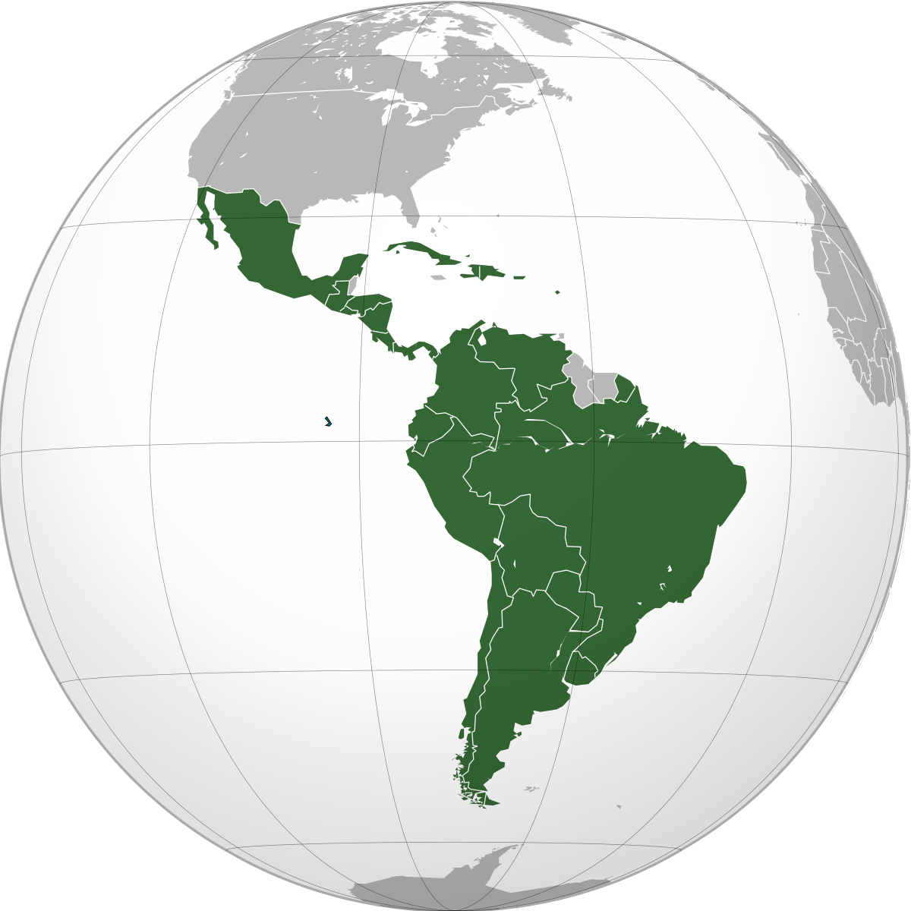
Latin America
Feb. 27 –
Mar 3

Slide 2
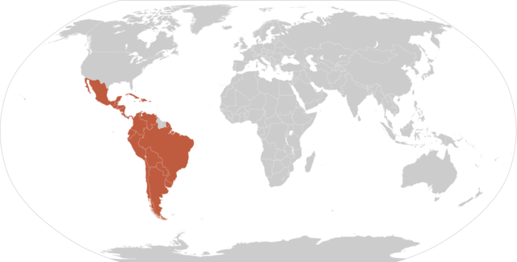
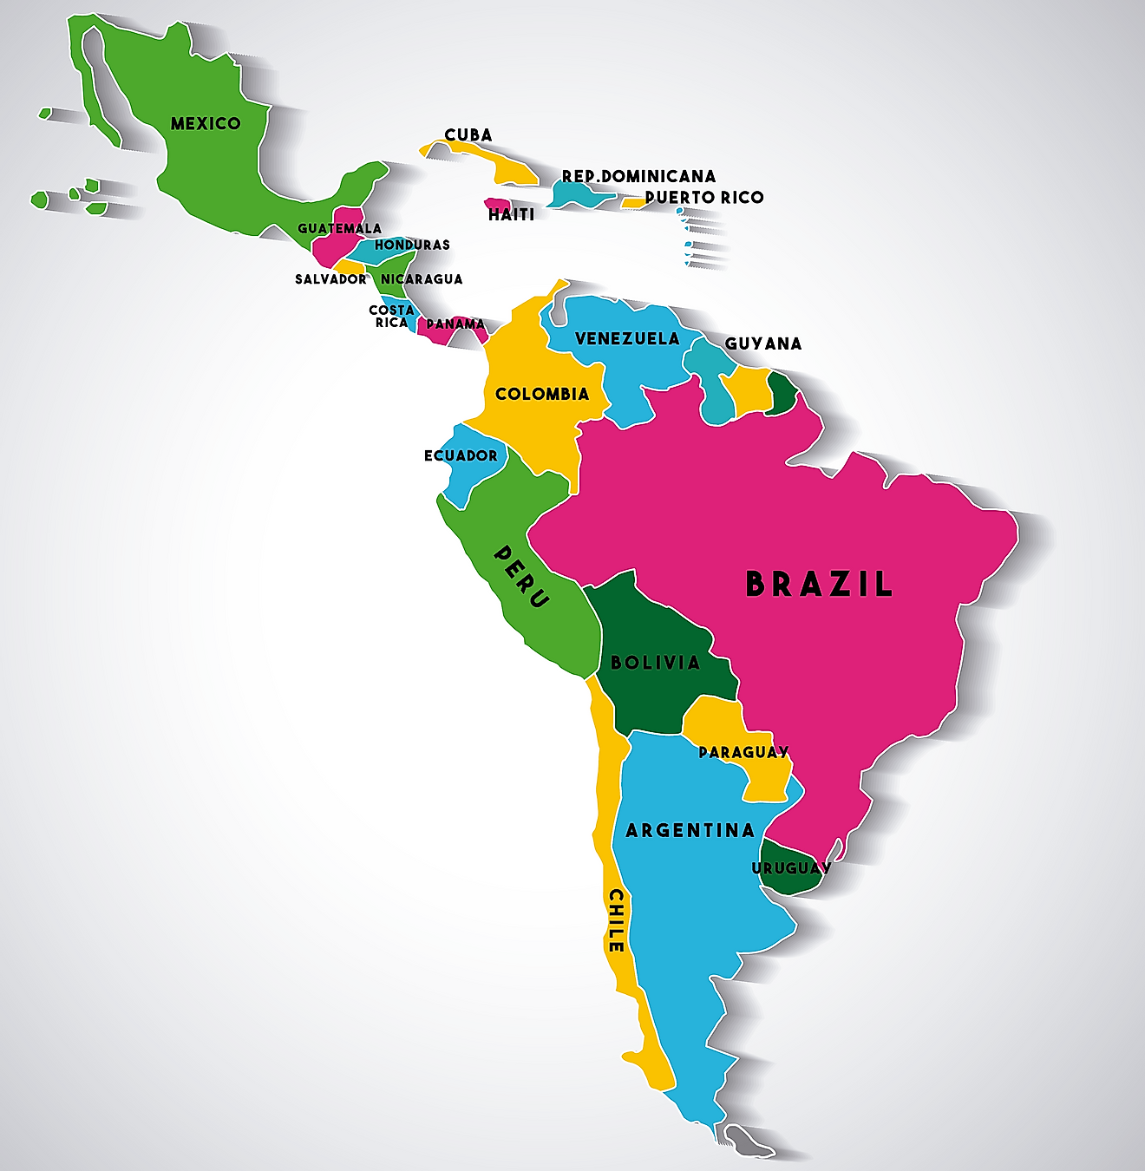
Latin America is generally understood to consist of the entire continent of South America in addition to Mexico, Central America, and the islands of the Caribbean whose inhabitants speak a Romance language. The peoples of this large area shared the experience of conquest and colonization by theSpaniards and Portuguese from the late 15th through the 18th century as well as movements of independence from Spain and Portugal in the early 19th century. Even since independence, many of the various nations have experienced similar trends, and they have some awareness of a common heritage.
www.britannica.com/place/Latin-America

Slide 3
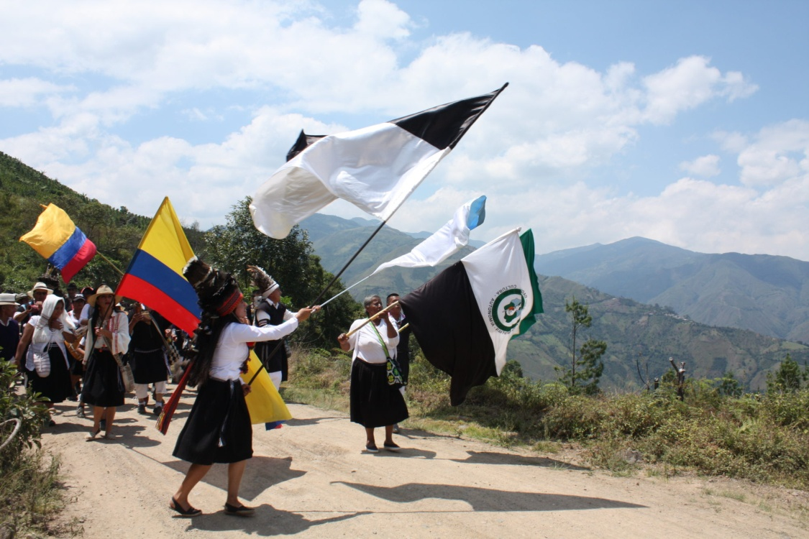
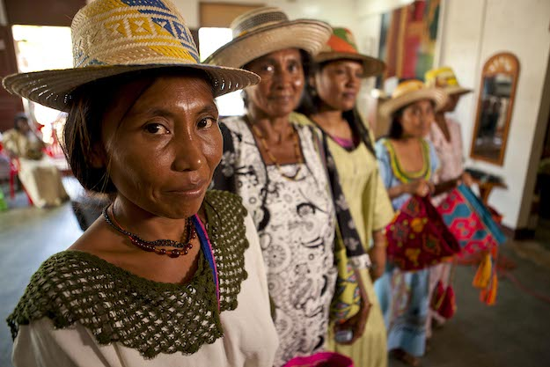
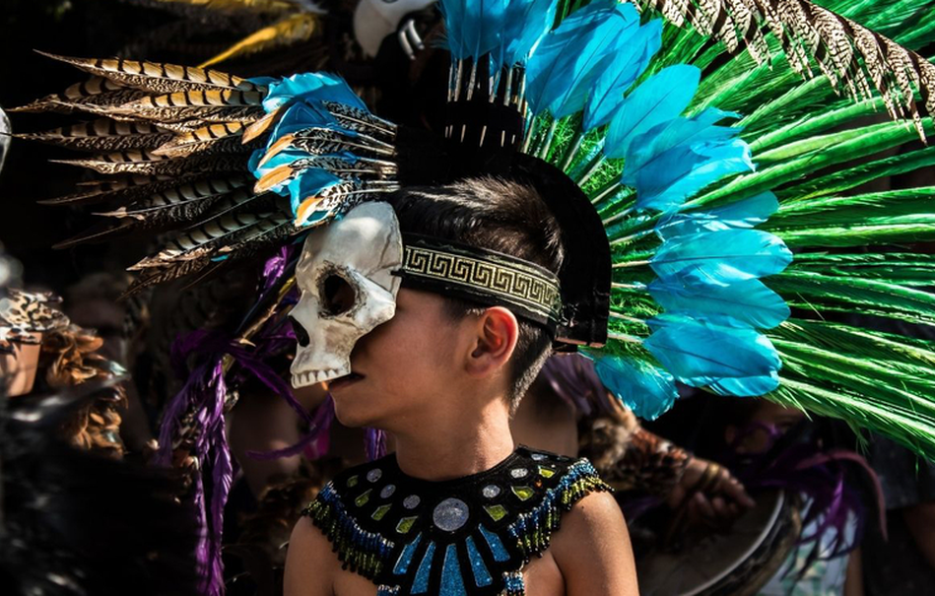

Slide 4
SS6E1 Analyze different economic systems.
a. Compare how traditional, command, and market economies answer the economic questions of 1-what to produce, 2-how to produce, and 3-for whom to produce.
SS6E2 Give examples of how voluntary trade benefits buyers and sellers in Latin America.
a. Explain how specialization encourages trade between countries.
b. Compare and contrast different types of trade barriers, such as tariffs, quotas, and embargos.
d. Explain the functions of the North American Free Trade Agreement (NAFTA).
SS6E3 Describe factors that influence economic growth and examine their presence or absence in Brazil, Cuba, and Mexico.
a. Evaluate how literacy rates affect the standard of living.
b. Explain the relationship between investment in human capital (education and training) and gross domestic product (GDP per capita).
c. Explain the relationship between investment in capital goods (factories, machinery, and technology) and gross domestic product (GDP per capita).
SS6G3 Explain the impact of location, climate, distribution of natural resources, and population distribution on Latin America.
a. Explain how the location, climate, and distribution of natural resources impact trade and affect where people live in Mexico, Brazil, and Cuba.

Slide 5
 | Monday 27 | Tuesday 28 | Wednesday 1 | Thursday 2 | Friday 3
Focus Standard(s) | SS6E.1a,E2a, E3b | SS6E.1a,E2a, E3b | SS6E.1a,E2a, E3b | SS6CG1-2 | SS6CG1-2
Learning Target(s) | Economic Systems | Economic Systems | Economic Systems | Government/ Civil Understanding | Government/Civil Understanding
Opening | Latin America Map (Study) | Latin America Map (Study) | Latin America Map (Study) | Latin American Government | Latin American Government
Work Session | Latin America Video: Economics Textbook p.358, 384,412,423 Latin America Project (MLK/LAL Reassess/Relearn | Latin America Video: Economics Textbook p.358, 384,412,423 Latin America Project (MLK/LAL Reassess/Relearn | Textbook p.358, 384,412,423 Latin America Project (MLK/LAL Reassess/Relearn | Textbook/ Cloze Notes Latin America Project (MLK/LAL Reassess/Relearn | Textbook/ Cloze Notes Latin America Project (MLK/LAL Reassess/Relearn
Closing | TOD | Think-Pair-Share | TOD | Think-Pair-Share | Group Discussion
Minor Assignments Due |  |  | Test #2 Economic System |  | MLK/LAL Project due
Major Assignments Due
Current Relearning & Reassessment Assignments (with due dates) |  | R&R for both Test #1 and Test #2 this week.
Vocabulary
Upcoming Major Assignments |  | Social Studies Project (Latin American Country/Island) incorporate language, religion, resources, environmental issues, government, economy, and history. MLK/LAL Project: research paper and graphic organizer will be given to students

Slide 6
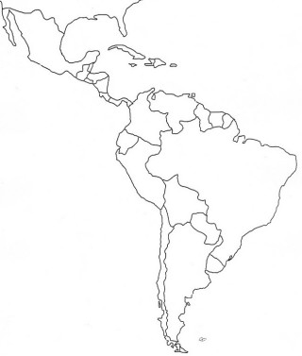
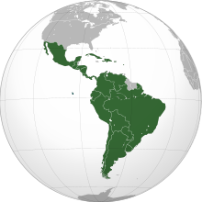
8
B
Latin America
1
M
D
M
2
C
A
3
e
5
4
H
G
F
G
7
H
K
6
H

Slide 7
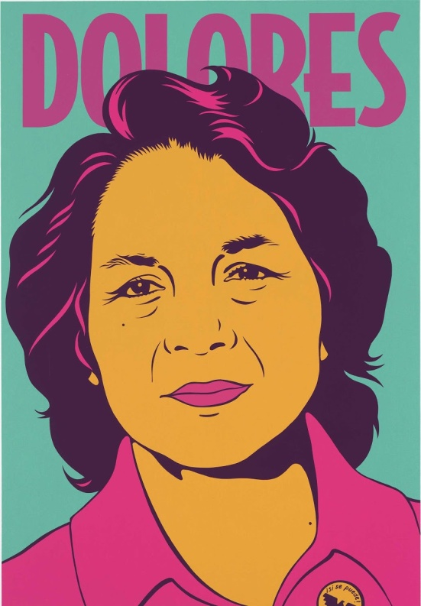
Students will working on their Social Studies Project.
This project will have two parts (Martin Luther King and Latin America Leaders).

Slide 8
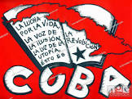
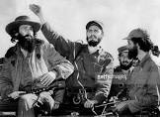
Cuban Revolution, armed uprising in Cuba that overthrew the government of Fulgencio Batista on January 1, 1959. The revolution’s leader, Fidel Castro, went on to rule Cuba from 1959 to 2008.

Slide 9
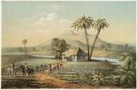
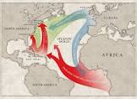
The first Africans taken to the Americas went in small numbers, not directly from Africa, but via Spain and Portugal and the Atlantic sea islands. The development of Brazilian sugar plantations, however, created a growing demand for African slaves. Other Europeans settling their own colonies in the Caribbean and North America followed the Brazilian pattern and became slaveholders, creating profitable plantations that produced commodities for international markets

Slide 10
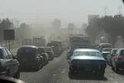
Air Pollution in Mexico City
Mexico City was once named as the world’s most polluted city in the world, but according to IQAir, a Swiss company which keeps track of the air quality of cities around the globe, Mexico City has now dropped down to the 917th most polluted city in the world in 2021. Though its concentration of airborne particles (PM 2.5) still currently exceeds the guideline of the World Health Organization (WHO), yet the colossal improvement is undoubtable. What has been done to successfully reduce air pollution in Mexico City? And what lessons can other cities learn from it?

Slide 11
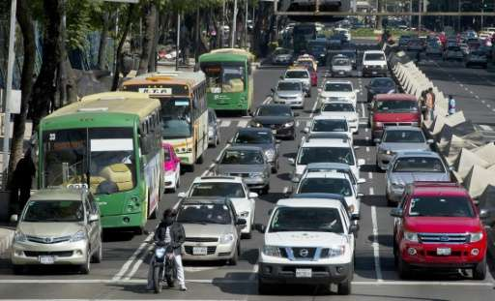
Click for video link
Air pollution smothers industrial cities across Mexico

Slide 12
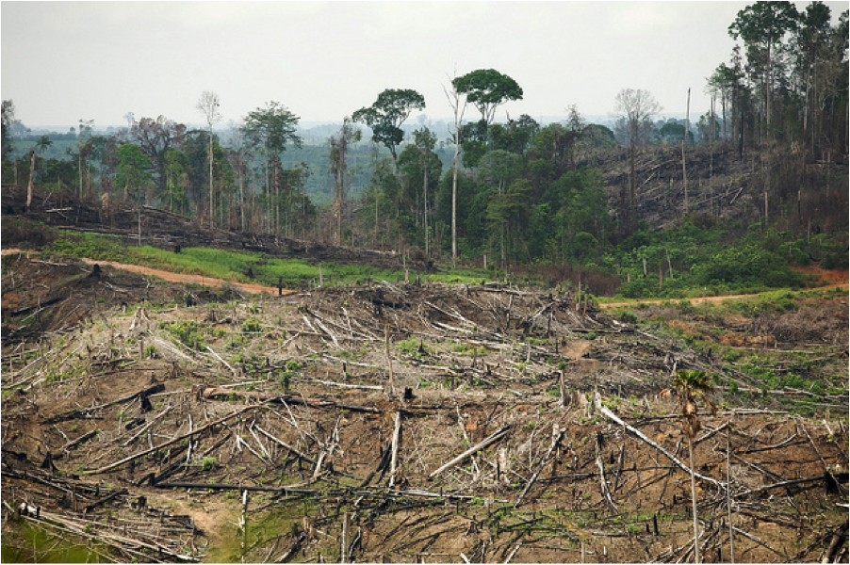
Destruction of the rain forest in Brazil
Humans are the main cause of rainforest destruction. We are cutting down rainforests for many reasons, including:
wood for both timber and making fires;
agriculture for both small and large farms;
land for poor farmers who don’t have anywhere else to live;
grazing land for cattle;
pulp for making paper;
road construction; and
extraction of minerals and energy.
An estimated 18 million acres (7.3 million hectares) of forest — roughly the size of Panama

Slide 13
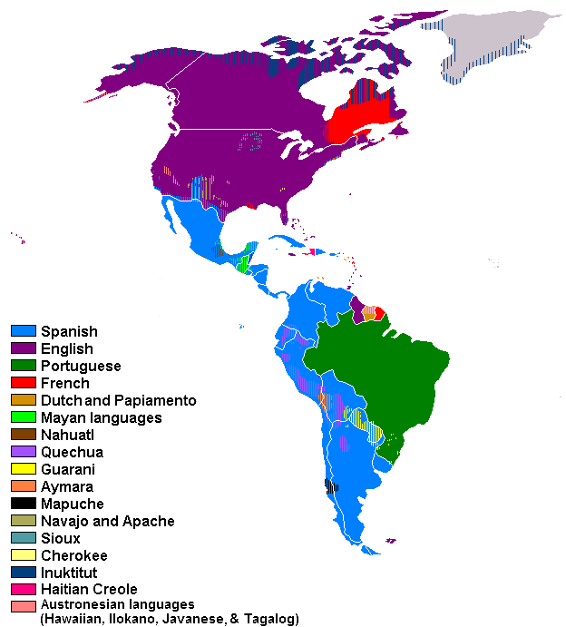
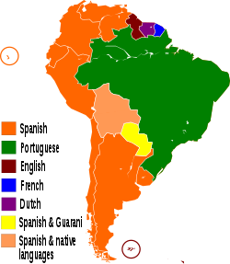
Languages of Latin America:
1) Spanish 2) Portuguese 3) English 4) German 5) Italian

Slide 14
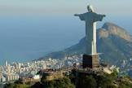
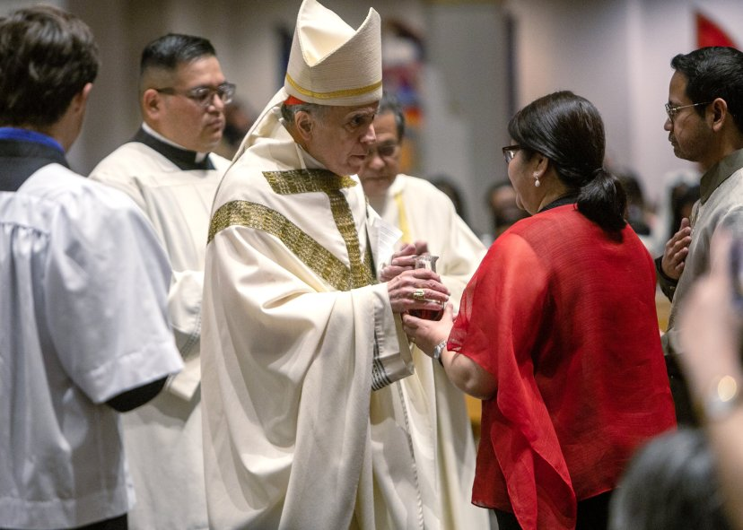
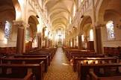
The majority of Latin Americans are Christians (90%), mostly Roman Catholics.

Slide 15
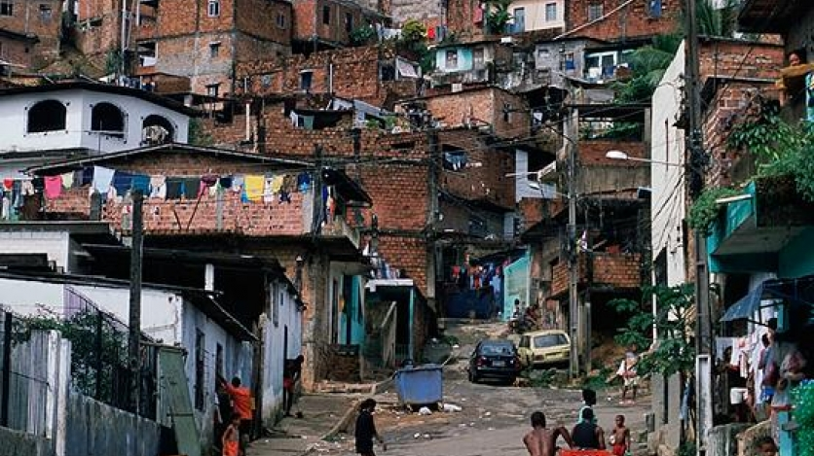
The Social Panorama 2022 report projects that 201 million people (32.1% of the region’s total population) live in situations of poverty, with 82 million (13.1%) of them in extreme poverty. The regional organization calls for urgently addressing the silent crisis in education to avert the risk of a lost generation.

Slide 16
Standards (Feb.6-10)
SS6H1 Explain conflict and change in Latin America.
a. Describe the influence of African slavery on the development of the Americas.
b. Describe the influence of the Spanish and the Portuguese on the language and religions of Latin America.
c. Explain the impact of the Cuban Revolution and describe the current relationship between Cuba and the United States.
d. Explain the impact of poverty, the war on drugs, and migration to the United States on Latin America.

Slide 17
Standards
SS6G1 Locate selected features of Latin America.
Locate on a world and regional political-physical map: Amazon River, Amazon Rainforest, Caribbean Sea, Gulf of Mexico, Atlantic Ocean, Pacific Ocean, Panama Canal, Andes Mountains, Sierra Madre Mountains, and Atacama Desert.
b. Locate on a world and regional political-physical map the countries of Brazil, Chile,
Colombia, Cuba, Mexico, and Panama.
SS6G2 Explain the impact of environmental issues in Latin America.
Explain the causes and effects of air pollution in Mexico City, Mexico.
Explain the environmental issue of destruction of the rain forest in Brazil.
SS6H1 Explain conflict and change in Latin America.
b. Describe the influence of the Spanish and the Portuguese on the language and religions of Latin America.
d. Explain the impact of poverty, the war on drugs, and migration to the United States on Latin America.

